Slide 1
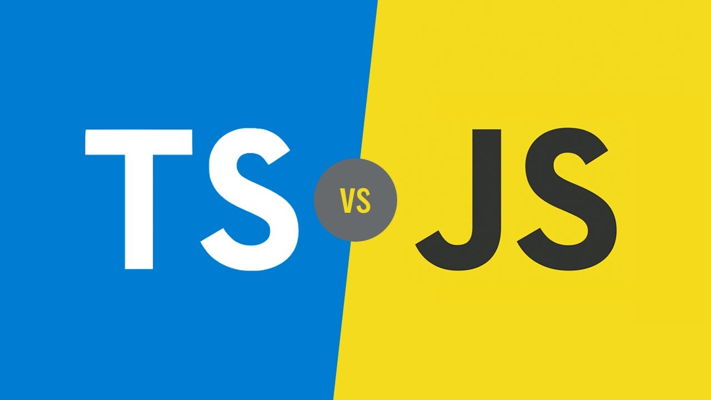

Slide 2
TypeScript VS JavaScript
Why Choose Typescript Over JavaScript?

Slide 3
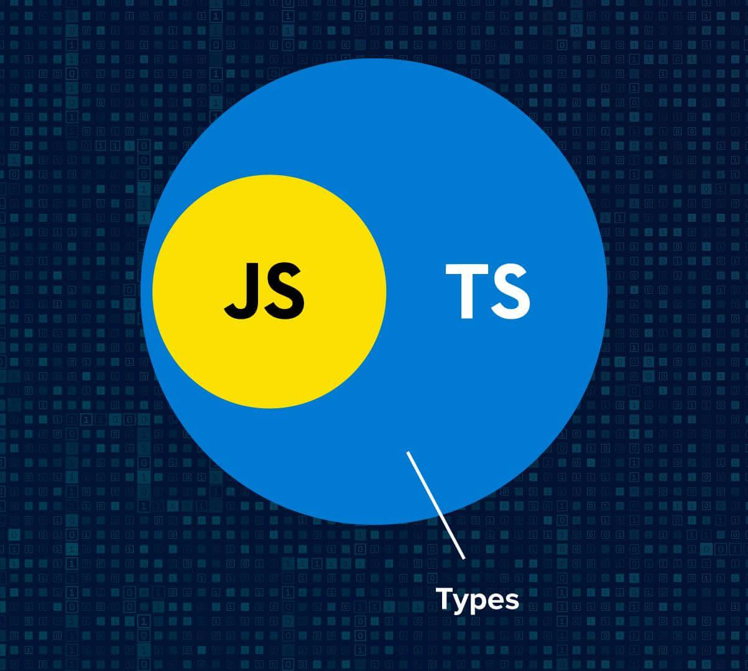

Slide 4
Types in TS are optional, and every JS file is a valid TypeScript file.

Slide 5
What is TypeScript?

Slide 6
What is TypeScript?
Briefly - it is JavaScript enhanced for large applications
Strict superset of JavaScript
Optional static types, OOP, and modules
Produces clean, idiomatic JavaScript
Developed by Microsoft

Slide 7
What brings TS?
Type Annotations
Compile Time Checking
Classes
Inheritance
Interfaces
Modules
Enums
Generics
Function Expressions

Slide 8
Typical problems with JS
Classic: 'undefined' is not a function.
Unexpected operations
Getting undefined/null/” ” in runtime
JS due to dynamic nature has no good support for IDE dev (mostly IDE uses intellisense based on codebase)
Mostly gets in runtime, hard to detect during the writing
 | JS | TS
[ ]+[ ] | “” | Error
{ }+[ ] | 0 | Error
{ } + { } | [object Object] | Error
“hello” - 1 | NaN | Error

Slide 9
TS: Pros and Cons

Slide 10
TypeScript Advantages
Low Risk: Idiomatic & pretty JavaScript output
Easy to debug
Makes it simple to migrate to/from TypeScript
Better structuring: modules, classes, interfaces
No inadvertent globals, other “Bad Parts”
ES6 now (classes, modules, async/await)
Optional types offer:
Compile time checks
Auto-complete
Automatic type inference
Most IDE has integration with TS and has good support for it
Code is “self documented”

Slide 11
TypeScript Disadvantages
More code to start working
Required compiler
Has strict flow and gets 100% profit only if whole project is support TS

Slide 12
TS: Small example

Slide 13
From JS to TS
function my_sum(a, b) {
return a + b;
}
let a = 4;
let b = "5";
my_sum(a, b);
file.js
It's not takes many time to start working with migration
function my_sum(a: number, b: number) {
return a + b;
}
let a: number = 4;
let a: number = 5;
my_sum(a, b);
file.ts

Slide 14
Digital and Typescript

Slide 15
Digital and Typescript

Slide 16
Happy coding!

